Slide 1
The Chi-Square Distribution

Slide 2

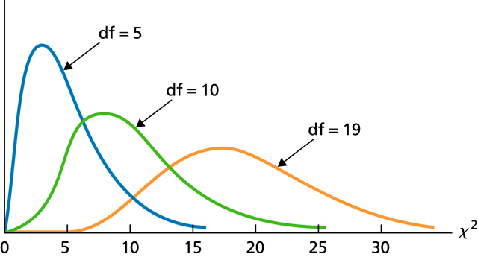
Figure 12.1
-curves for df = 5, 10, and 19

Slide 3
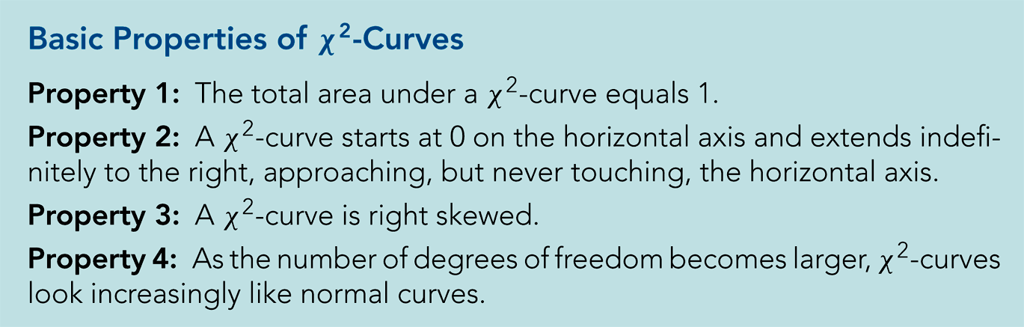
Key Fact 12.1

Slide 4
Chi-Square Goodness-of-Fit Test

Slide 5
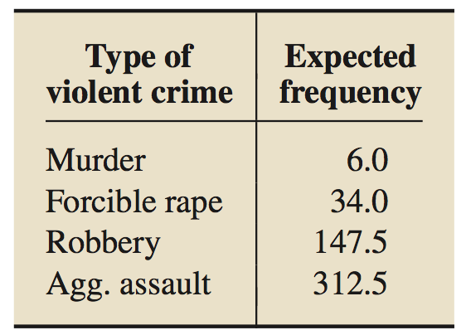
Table 12.3
Expected frequencies if last year’s violent-crime distribution is the same as the 2010 distribution

Slide 6
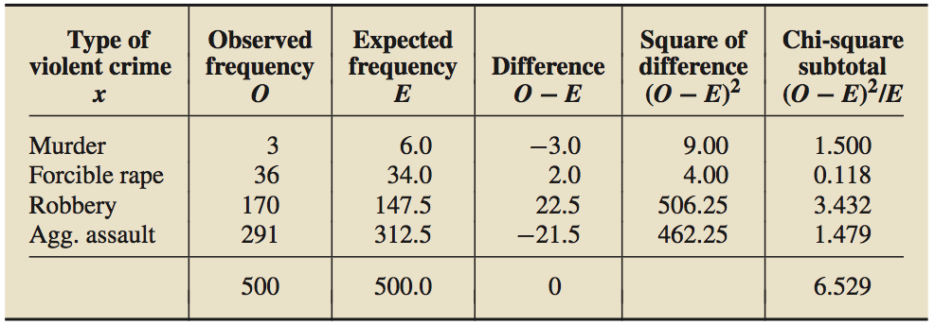
Table 12.4
Calculating the goodness of fit

Slide 7
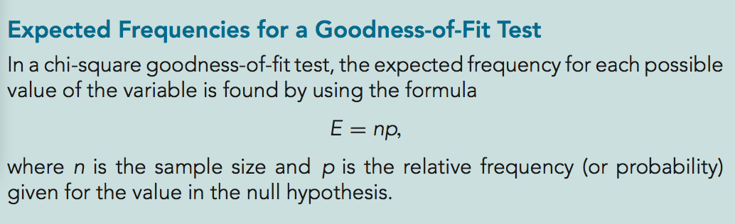
Formula 12.1

Slide 8
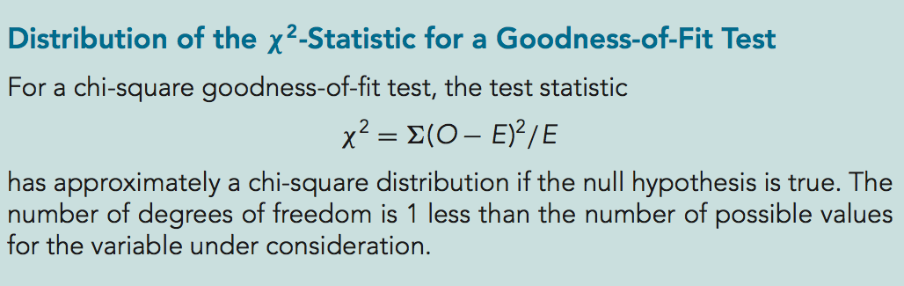
Key Fact 12.2

Slide 9
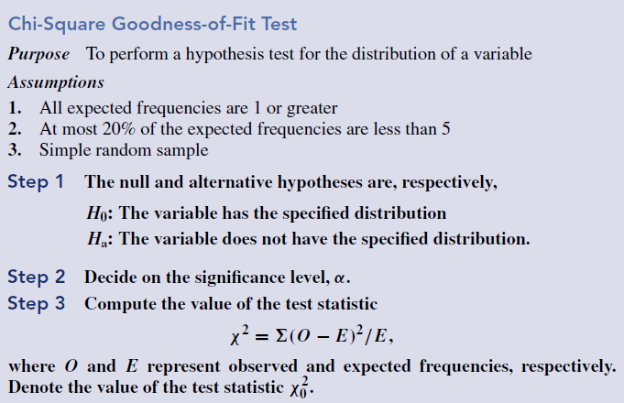
Procedure 12.1
Notes:
Delete slide and insert procedure 13.1 from page 655

Slide 10
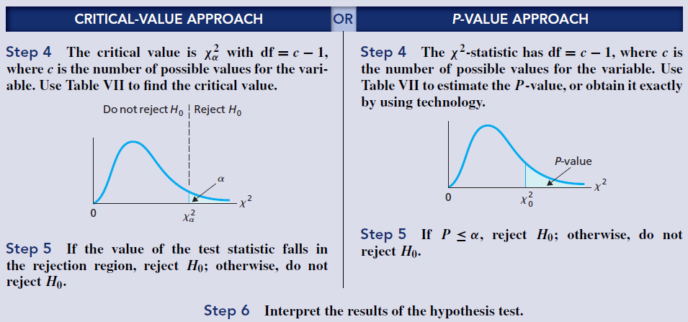
Procedure 12.1 (cont.)

Slide 11
Section 12.3
Contingency Tables; Association

Slide 12
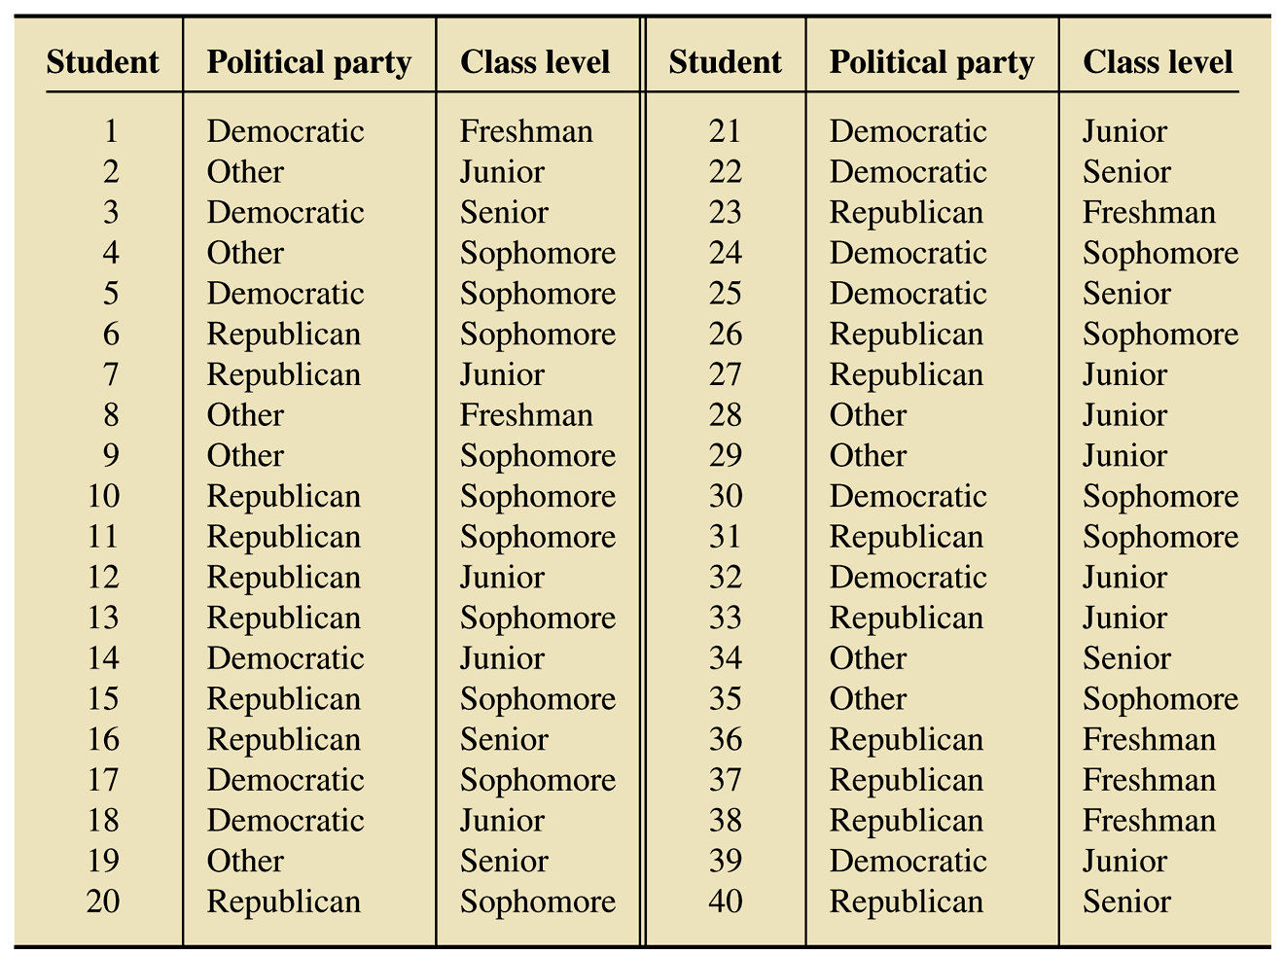
Table 12.7
Political party affiliation and class level for students in introductory statistics

Slide 13
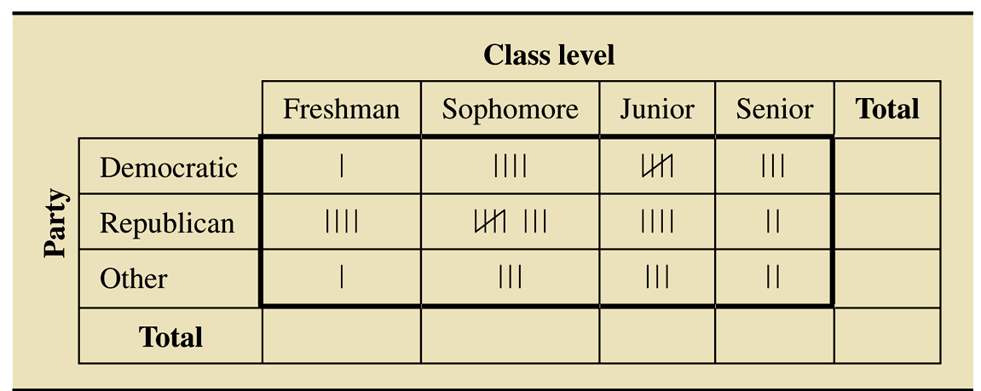
Table 12.8
Preliminary contingency table for political party affiliation and class level

Slide 14
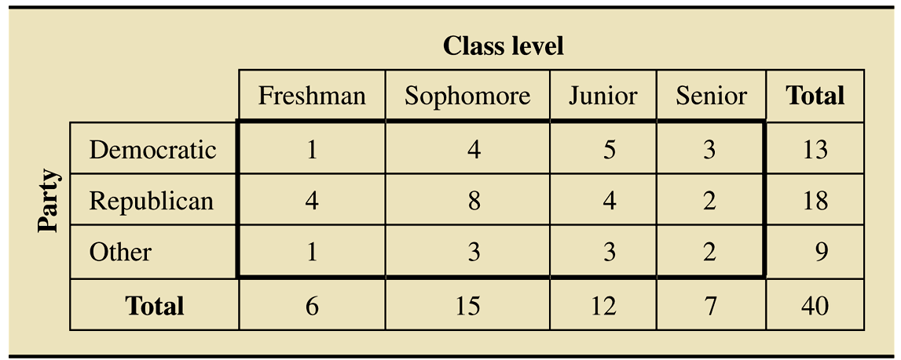
Table 12.9
Contingency table for political party affiliation and class level

Slide 15
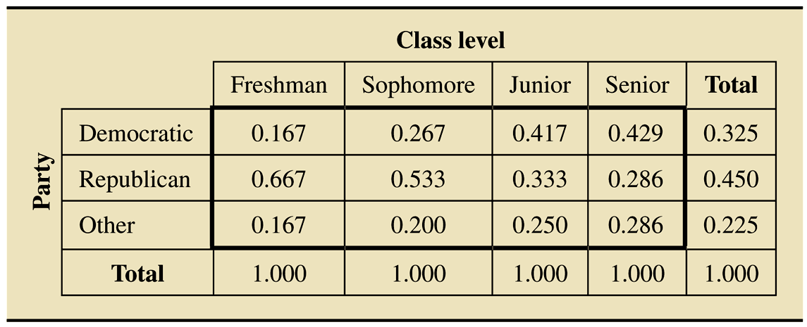
Table 12.10
Conditional distributions of political party affiliation by class level

Slide 16
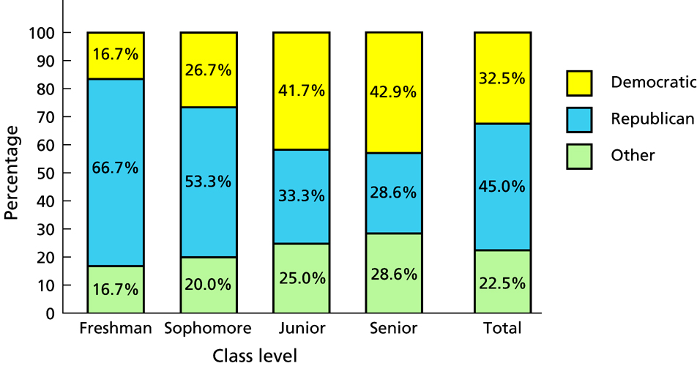
Figure 12.4
Segmented bar graph for the conditional distributions and marginal distribution of political party affiliation

Slide 17
Definition 12.1
Association between Variables
We say that two variables of a population are associated (or that an association exists between the two variables) if the conditional distributions of one variable given the other are not identical.

Slide 18
Chi-Square Independence Test

Slide 19
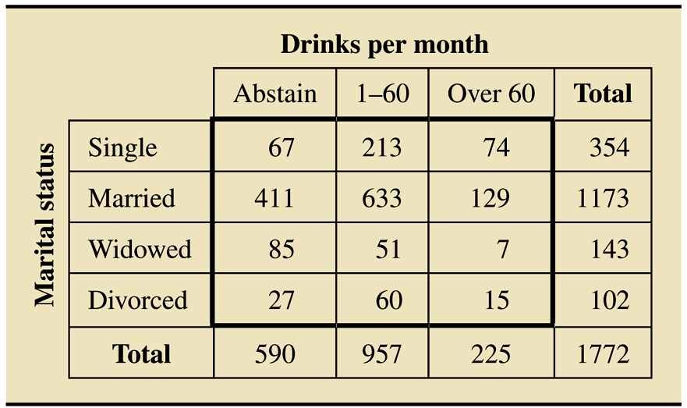
Table 12.13
Contingency table of marital status and alcohol consumption for 1772 randomly selected U.S. adults

Slide 20
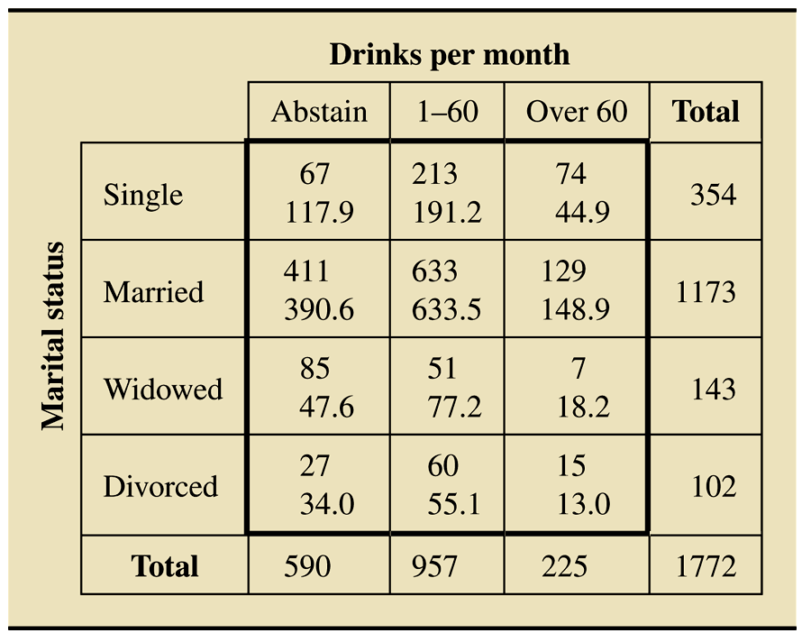
Table 12.14
Observed and expected frequencies for marital status and alcohol consumption (expected frequencies printed below observed frequencies)

Slide 21
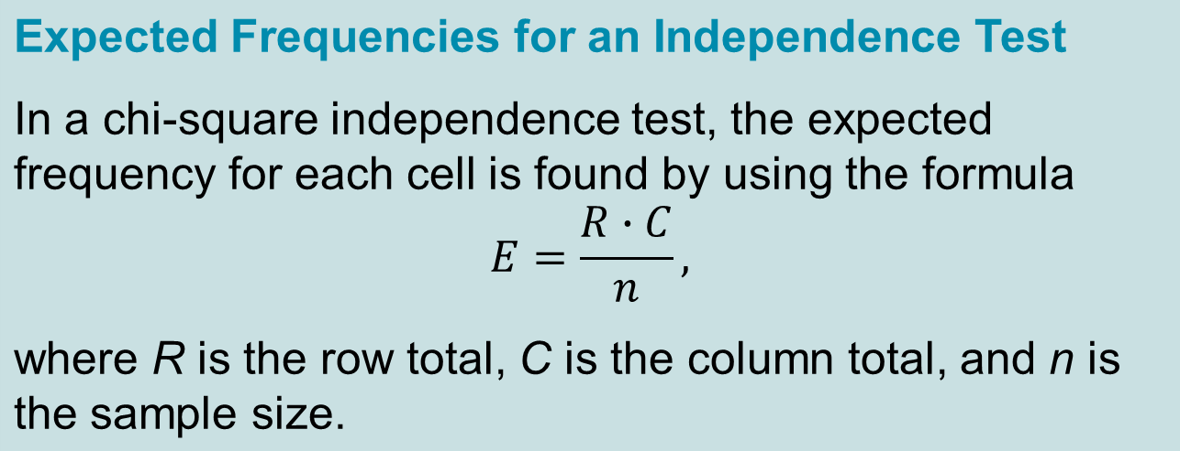
Formula 12.2

Slide 22
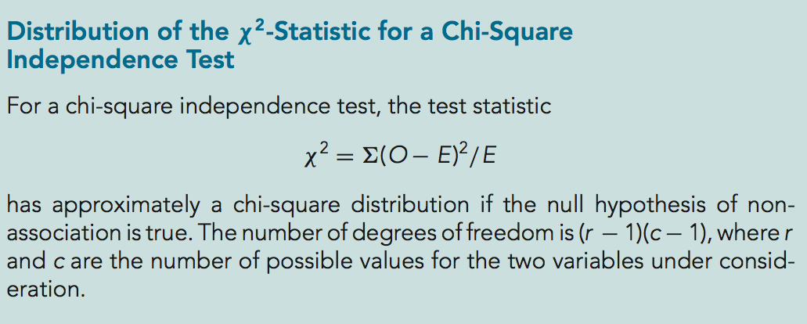
Key Fact 12.3

Slide 23
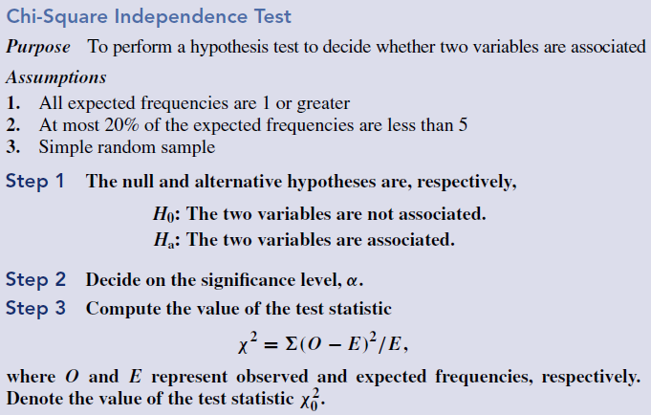
Procedure 12.2

Slide 24
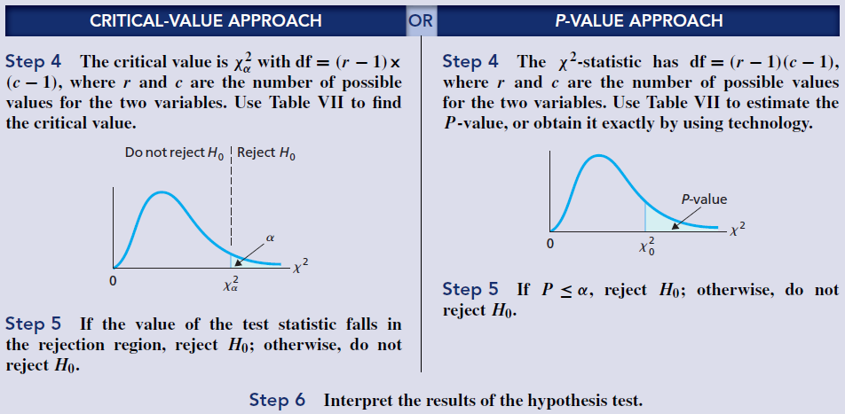
Procedure 12.2 (cont.)

Slide 25
Chi-Square Homogeneity Test

Slide 26
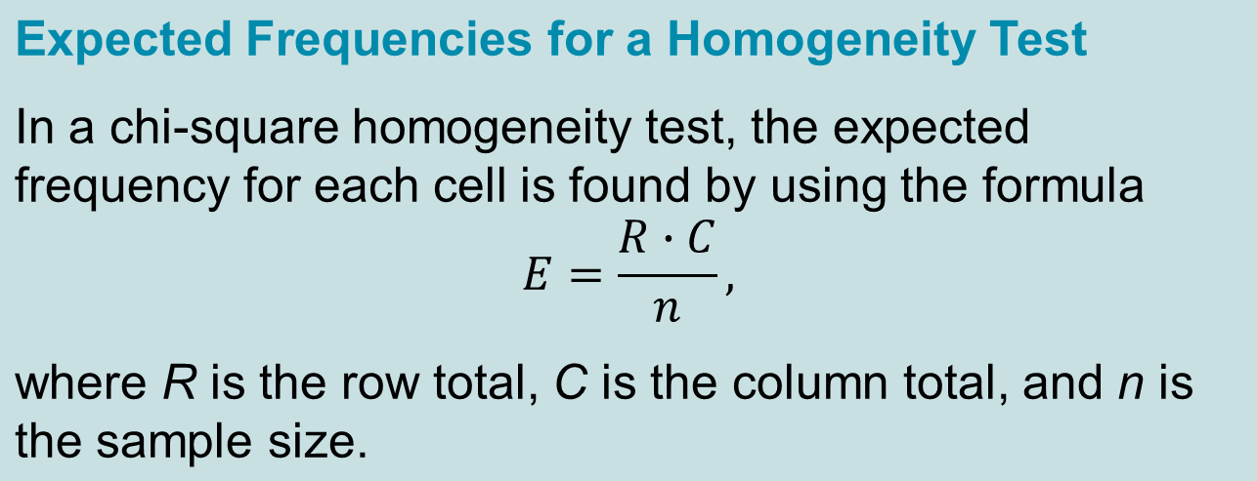
Formula 12.3

Slide 27
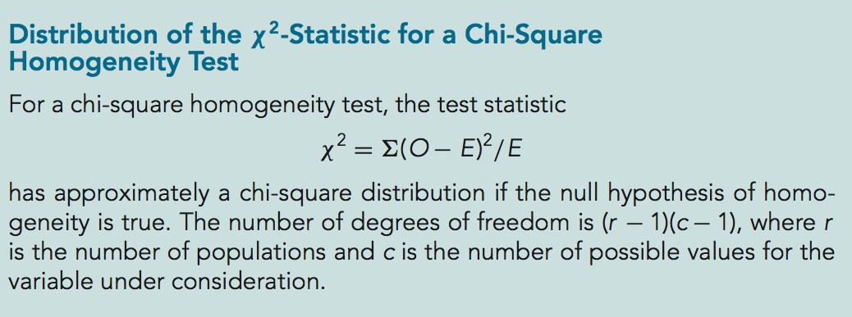
Key Fact 12.4

Slide 28
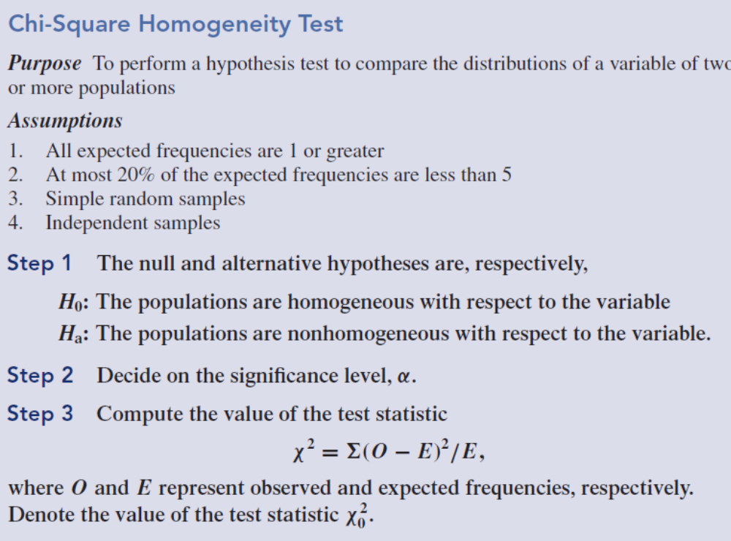
Procedure 12.3

Slide 29
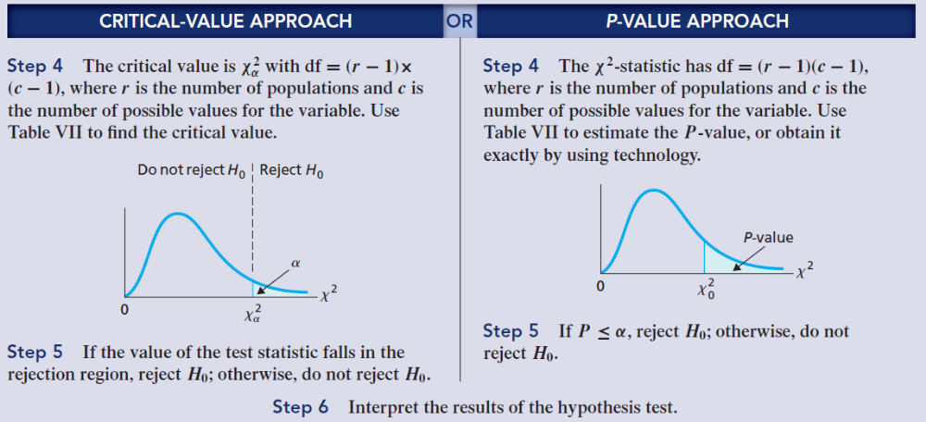
Procedure 12.3 (cont.)

